Slide 1

Micro Credit Prediction
Konatala Mohit
Intership-23 , ID-34

Slide 2

Abstract
Introduction
Descriptive Analysis
Data Visualization
Data cleaning and modifying
Feature Selection and Model Training
Conclusion

Slide 3

Abstract
Data analysis and model building on provided data from telecom industry client to predict the classification of the i.e., if the customer can payback loan amount in time.

Slide 4

In this I will be discussing about micro credit prediction using few of the machine learning models via python and its libraries. In simple terms micro credit means a loan of small amount. The primary objective of micro credit is to help raise the income and standard of living of the below poverty line category families. Micro credit is only applicable to lower income families and it is provided by micro credit institutes of the country. Communication devices have become primary digital gadget to pursue our normal life in today’s life. On an average a person uses his phone for 4 hours of the day i.e., texting, internet surfing, streaming online or calling etc. Telecom industries have also initiated micro credit service to help provide services to lower income class which would help sustain their lives.

Slide 5

Exploratory Data Analysis
Objective:
Analysis of the data set and summarizing the factor that effect the classification of the label.
Understanding the Data Via Descriptive analysis
Size of the data is small contains only 209593 and 37 rows in train and test respectively
Label is the target column

Slide 6
Data contains does not contain any Null Values
Data contains both numerical except few columns
Descriptive analysis is used as it gives the basic value Insite of the data in our dataset.
It helps in organize the data and summarize the data while describing the characteristic of data.

Slide 7
Data Visualization
Data visualization is one simplest way to get a proper idea about the characteristics of the data just from vision. In much simpler words , we Visualize the descriptive stats of the data in pictorial format. Also the data characteristic are represented in eye soothing way
Identifying pattern, understanding is the data is more easier through visuals.

Slide 8
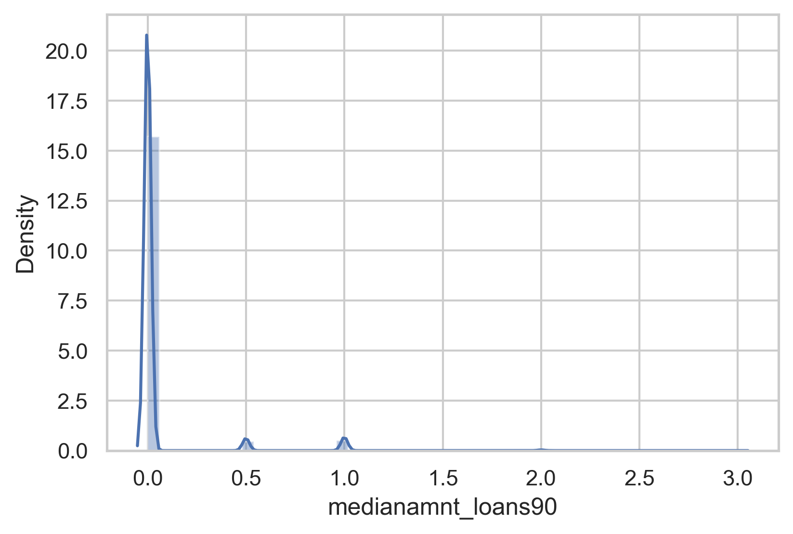
Independent variables influencing the target variable pie chart

Slide 9
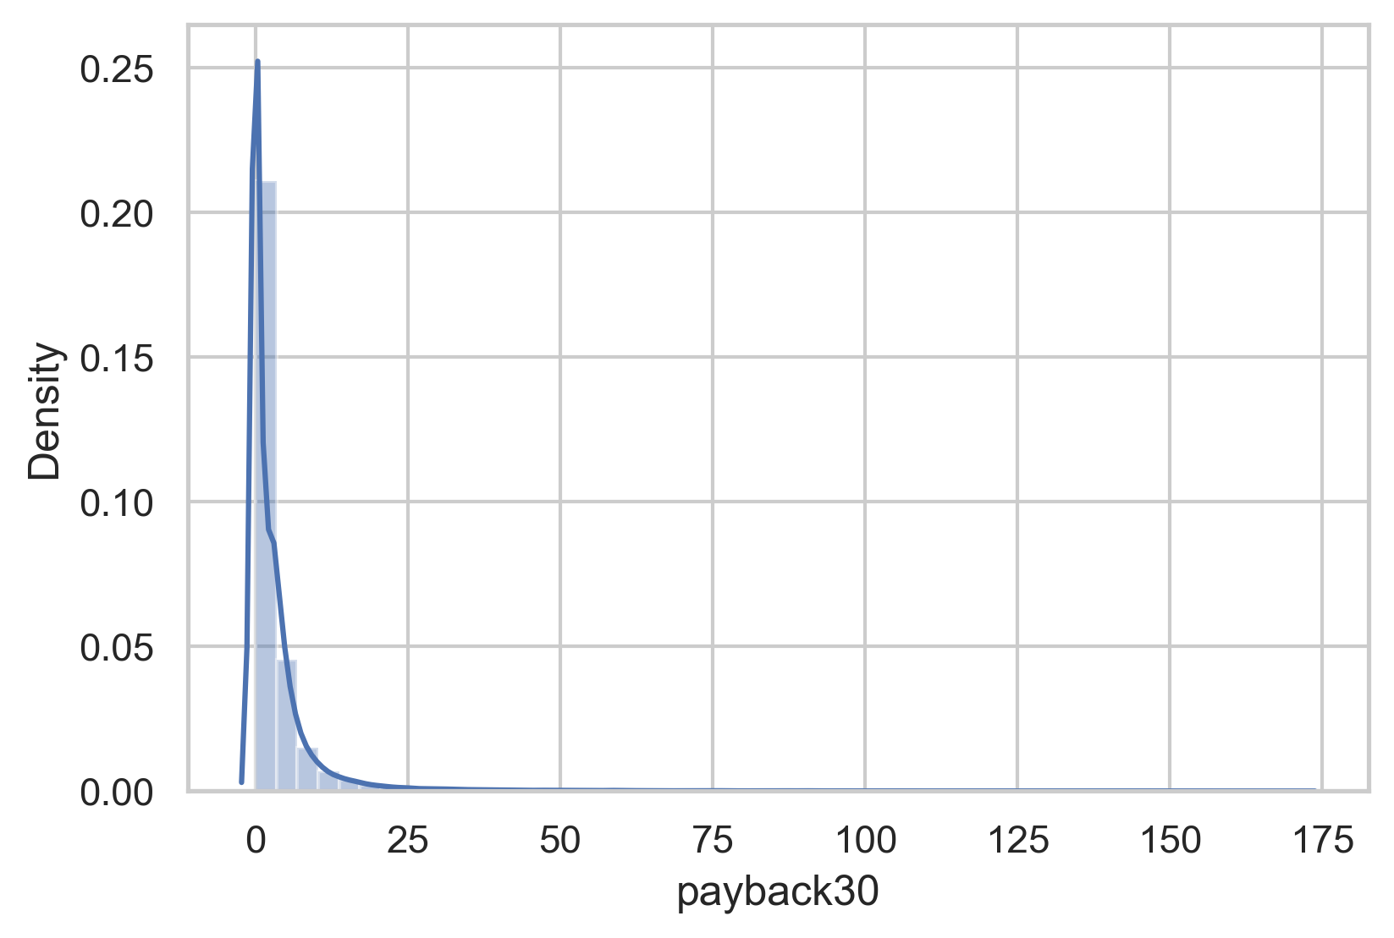
Independent variables influencing the target variable pie chart

Slide 10
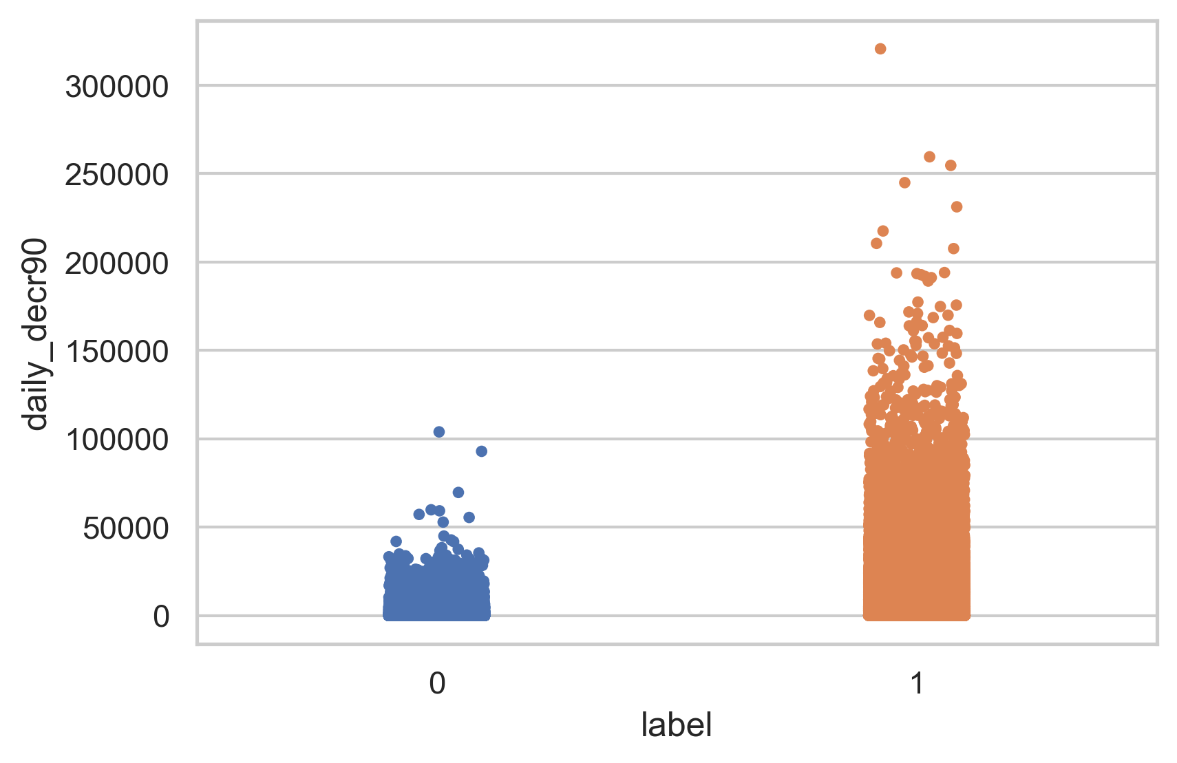
Bivariate Analysis

Slide 11
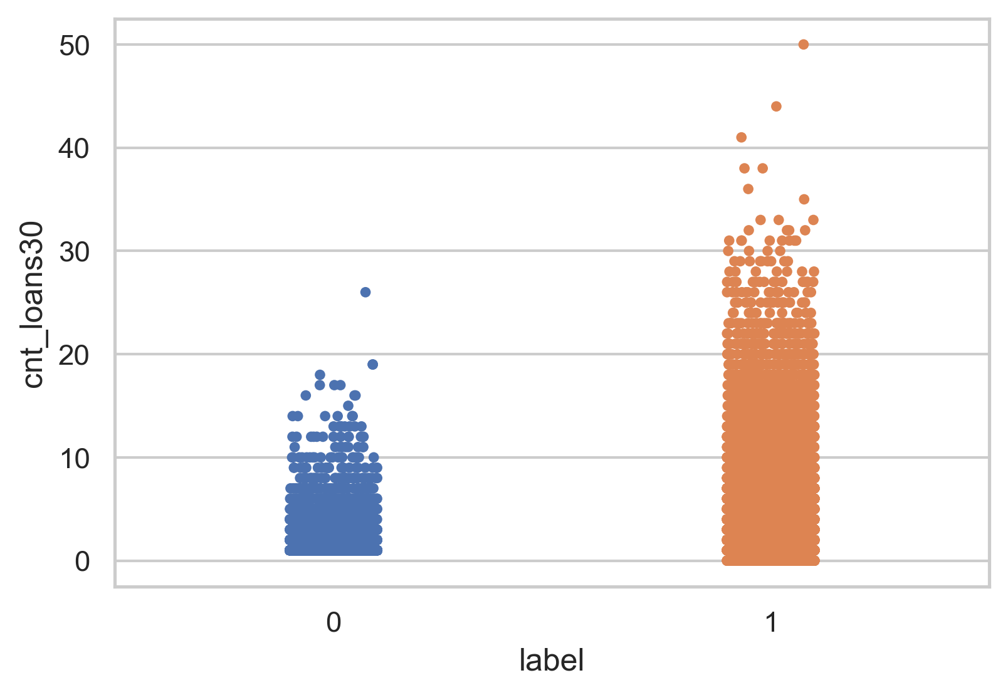
Bivariate Analysis

Slide 12
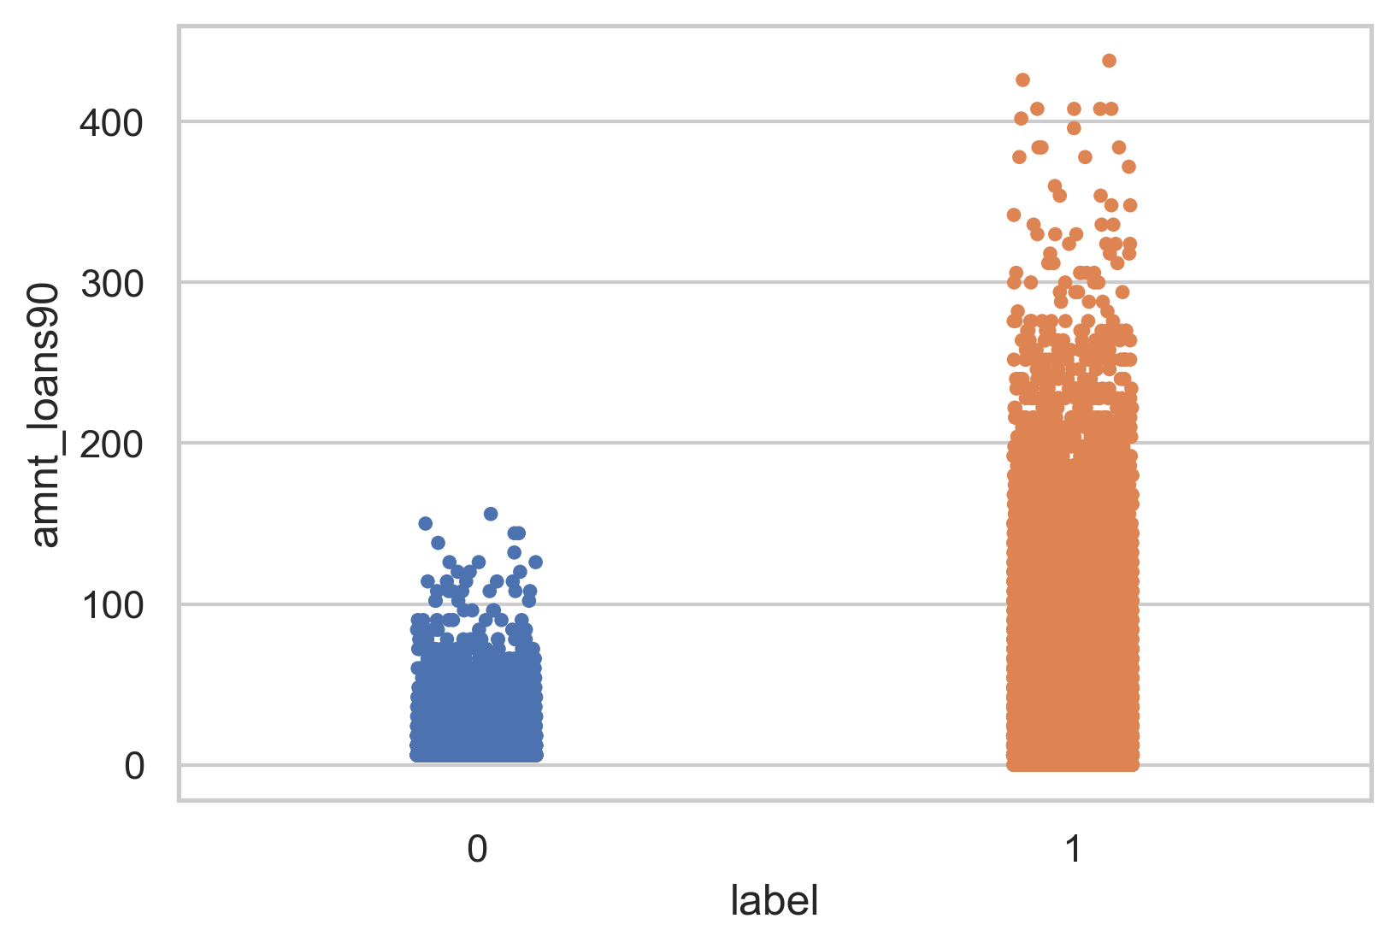
Bivariate Analysis

Slide 13
Cleaning the Data
Cleaning data is one of the most important procedure in data analysis i.e. detecting and modifying or removing the inaccurate data from the dataset so as improve data quality
Tasks in data cleaning:
Handling null values
Arresting outliers
Removing Skewness if required
Feature Selection

Slide 14
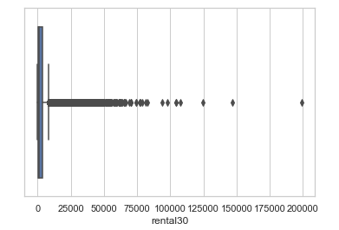
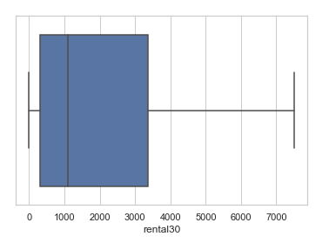
Arresting outliers observed in visualization:
Some of the columns have outliers and have to dealt with accordingly. Example is shown below.
Feature Selection and Normalization:
Feature selection is done on the basis of corelation (also to remove multi-collinearity) with the target variable and to improve model training. Normalization to remove bias from the data while feeding it to ML.

Slide 15
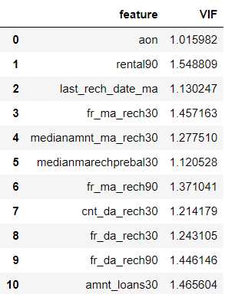
Variance Inflation Factor:
After Normalizing the data and feature selection VIF is used to cross check if there is any existence of multi-collinearity between the independent variable
Note :
VIF and Normalization should done only on independent variables i.e. after splitting the target data column.

Slide 16

Below the keys point in Summarizing the data analysis of Micro Credit Prediction data:
Size of the Dataset is 209593 rows and 34 columns.
No missing values in the dataset.
Converted categorical data into numerical data
outliers have been dealt with.
Feature selection of independent data is done via heatmap and VIF value.
Separate features and prediction variables into two separate list.

Slide 17
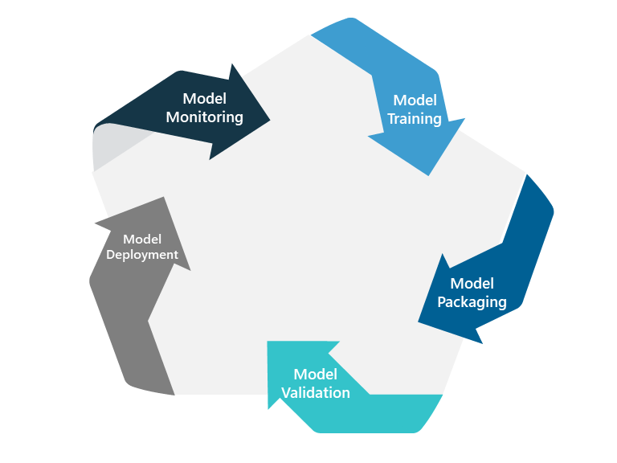
Model Training and Testing
Splitting the Data into Train and Test sets
SMOTE resampling
Using hyperparameter tuning to get the best estimator for the model
Model Training
Cross Validation
Model Testing
Saving the model

Slide 18
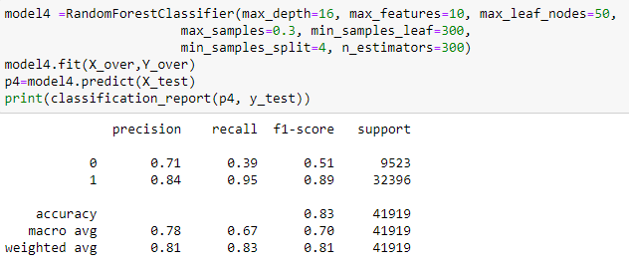

Slide 19
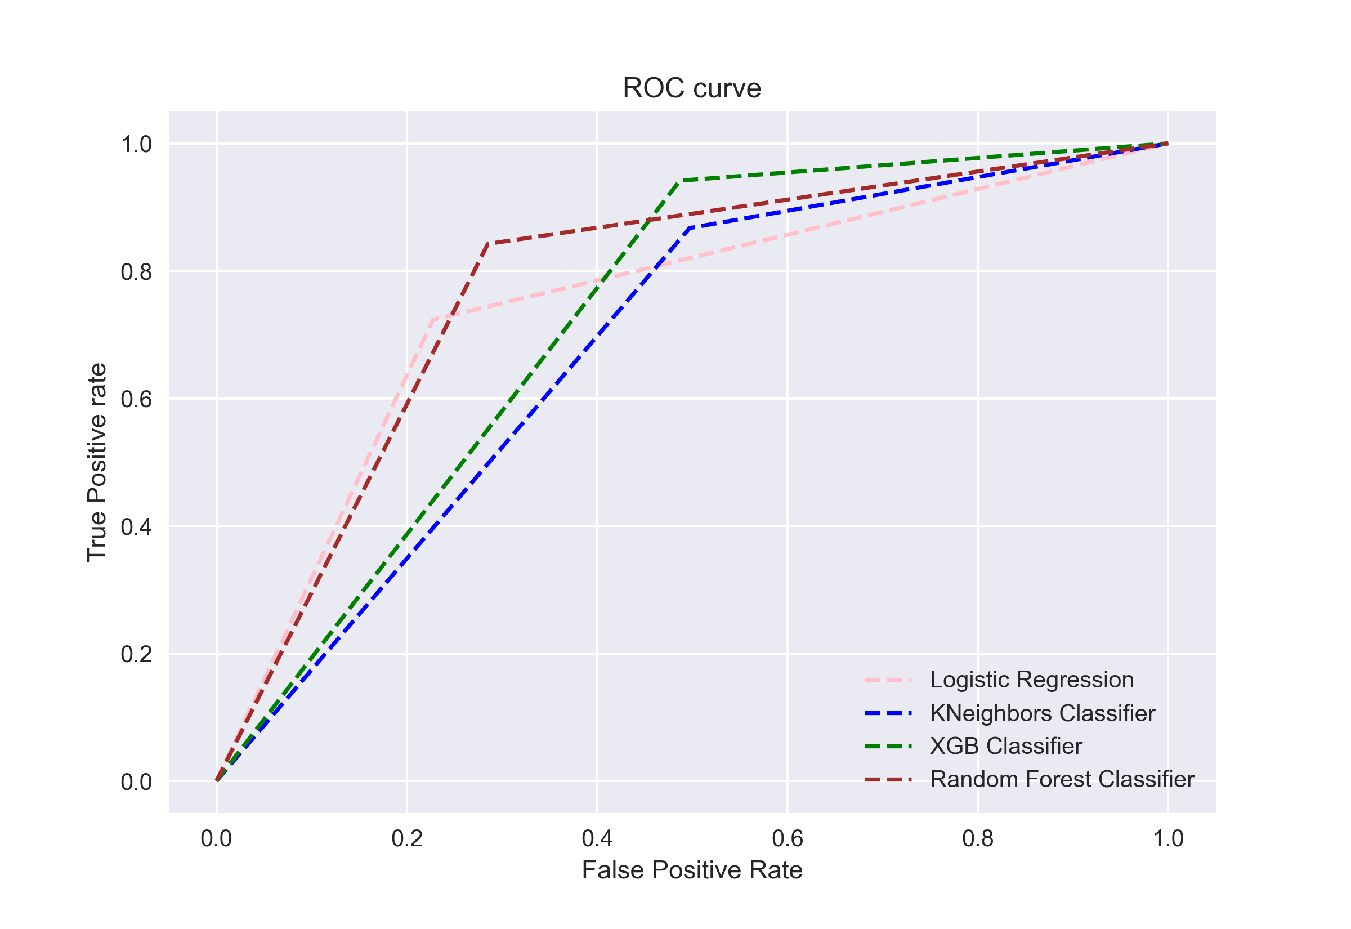

Slide 20

Limitations of this work and Scope for Future Work:
The label predicted are only limited to particular cellular telecom industry. When we try to predict for different cellular network of another country the machine learning model will fail. To improve the model efficiency, we can add more of failure label in order to balance the data and get much improved precision, recall and f1-score for the given model.
Conclusion:
In the whole dataset amount of loan and median of loan amount in last 30 days column has the most influence on the label columns. Payback30 and month columns are the other factors which have good influence on the label prediction.

